Slide 1
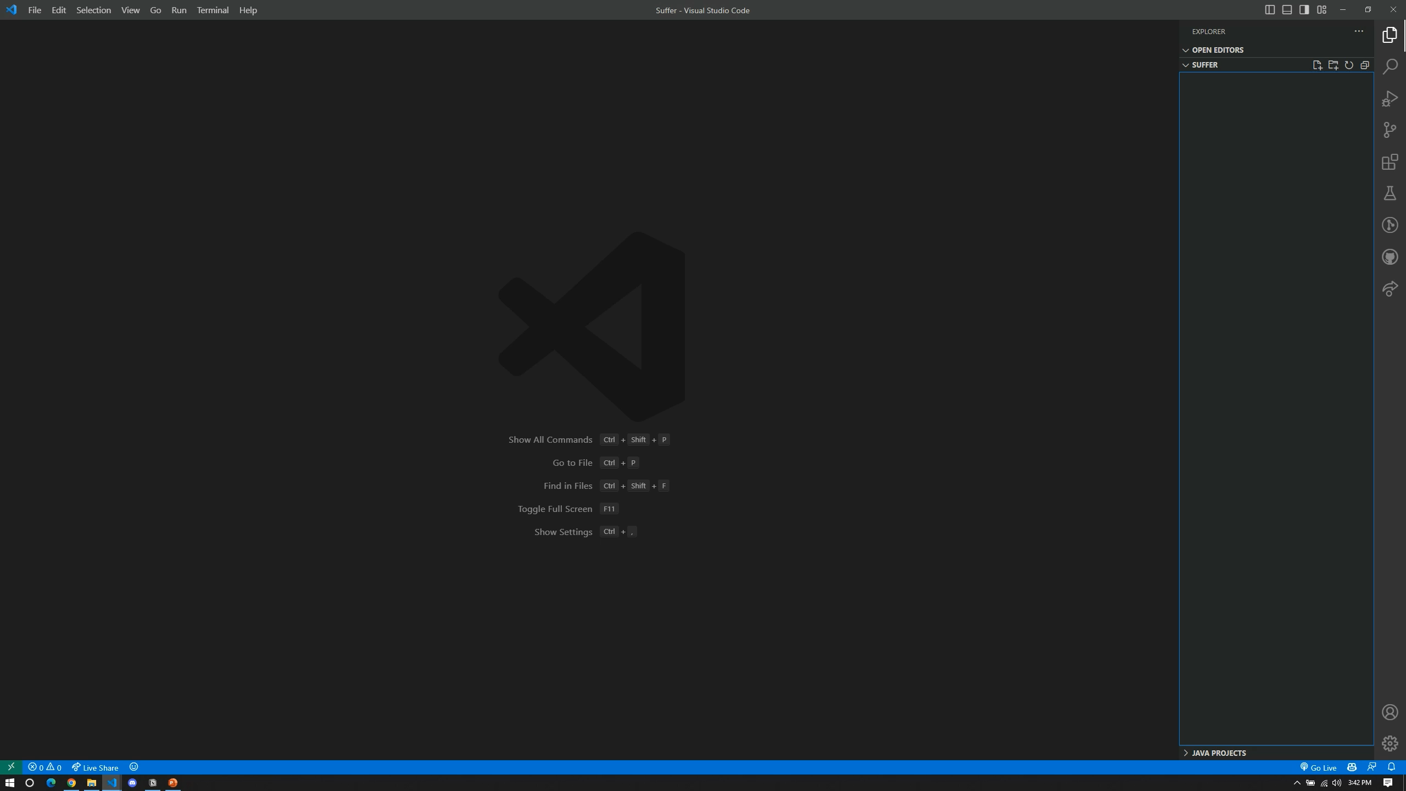

Slide 2

Keylogger in Java
Khushboo Hamid CSE-20-01
Syed Aarish Shah CSE-20-50

Slide 3
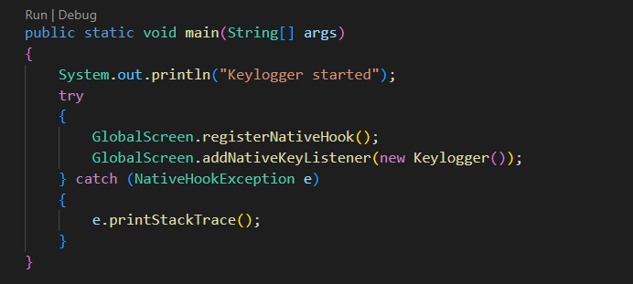
Driver Code

Slide 4
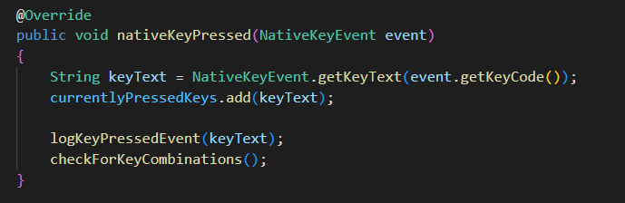
KeyPressed

Slide 5
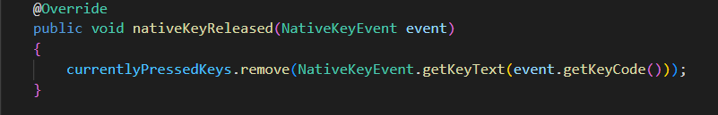
KeyReleased

Slide 6
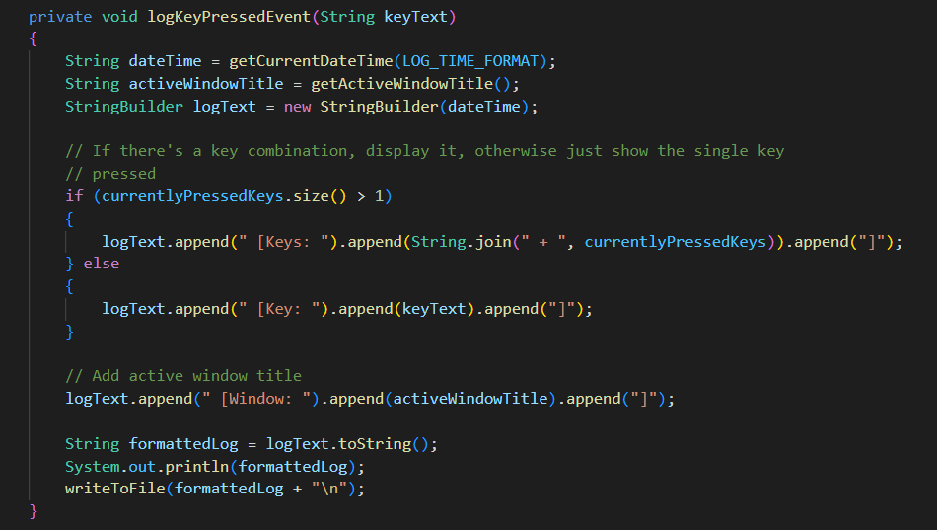
Log Key Pressed Event

Slide 7
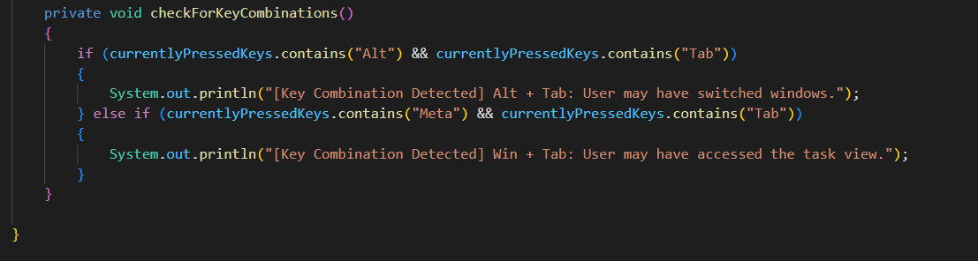
Key Combinations

Slide 8
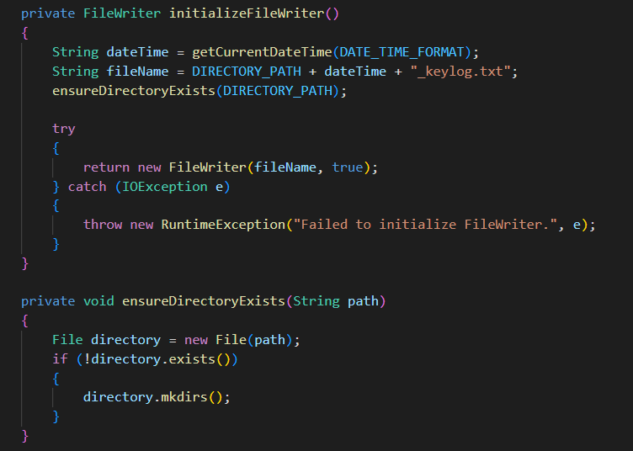
File Writer & Ensure Directory

Slide 9
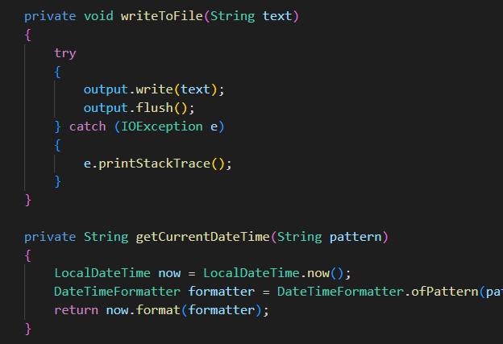
More functions! (QoL Functions)

Slide 10
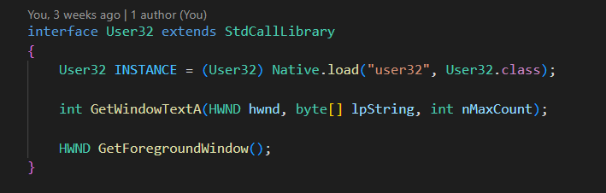
The System!

Slide 11
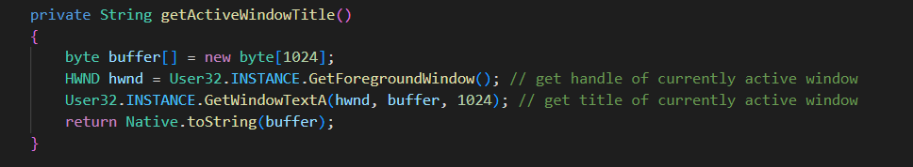
Get the Active Window

Slide 12

Thank you

